Slide 1


PRESENTATION ON DEPRESSION ANALYSIS USING COVOLUTIONARY NURAL NETWORKS
PRESENTED BY ROLL NO. GUIDED BY
Mr : DAHALE AASHISH S B150423021 PROF.DR.R.V.BABAR Ms : SHREYA THAKUR B150423097
Mr : GAUTAM KUMAR B150423028
B.E.(EI & TC)
Department of Electronics and Telecommunication Engg.
STES’s
Sinhgad Institute of Technology, Lonavala
July 2020

Slide 2
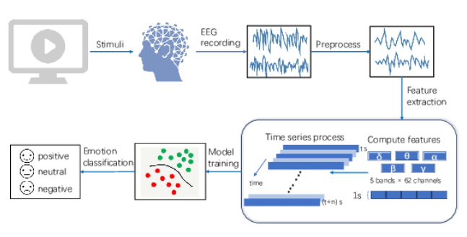
FLOW OF DEPRESSION ANALYSIS

Slide 3
AGENDA
INTRODUCTION
PROBLEM STATEMENT
OBJECTIVES
BLOCK DIAGRAM
TOOLS USED
APPLICATIONS
REFERENCES

Slide 4
INTRODUCTION
In Electroencephalogram (EEG) is a popular method for diagnosing various neurological diseases. Major Depressive Disorder (MDD) is a mental health disorder that can be diagnosed and treated by making use of EEG.
G. One of the main challenges in using EEG to accurately identify depression is complexity and variation that exist in the EEG of a depressed person. Manually reading EEG and diagnosing depression is very challenging. An efficient computer aided method can be used for this task. Of the many methods that exists, a deep neural network method called Convolution Neural Networks (CNN) proved to be the most efficient.
In this a multi-layer deep CNN algorithm is implemented to diagnose depression from EEG of patients. Depression is classified based on a severity index into mild, moderate and major classes. The accuracy, sensitivity and specificity were measured by varying various parameters of the proposed algorithm

Slide 5
PROBLEM STATEMENTS
It is difficult to achicheve result of depression level manually by doctors.
it is time consuming and require doctors attaintion for long time

Slide 6
OBJECTIVES
To help doctors in getting correct diagnosis depression from EEG of patients Easily.
Reduce time of diagnosis

Slide 7
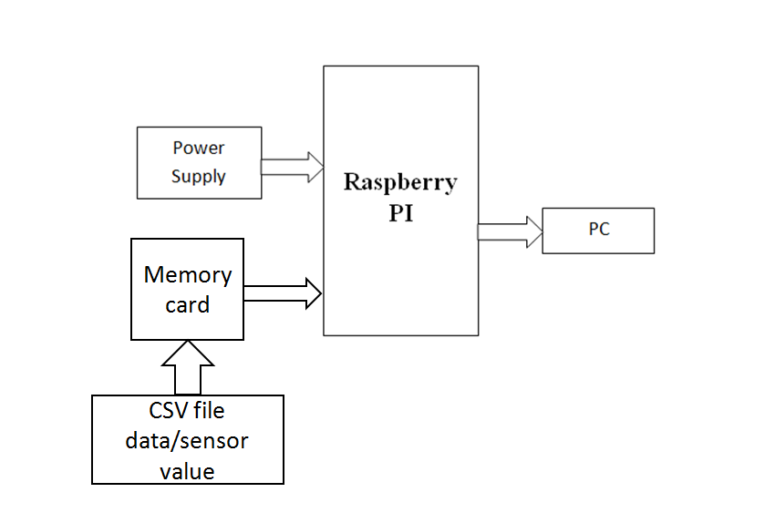
BLOCK DIAGRAM OF DEPRESSION ANALYSIS USING COVOLUTIONARY NURAL NETWORKS

Slide 8
Tools used:
Hardware:
Raspberry pi 3 model B+
USB Cable
Software:
Raspbian programming for the raspberry pi board
Open EEG data
Language: Python

Slide 9
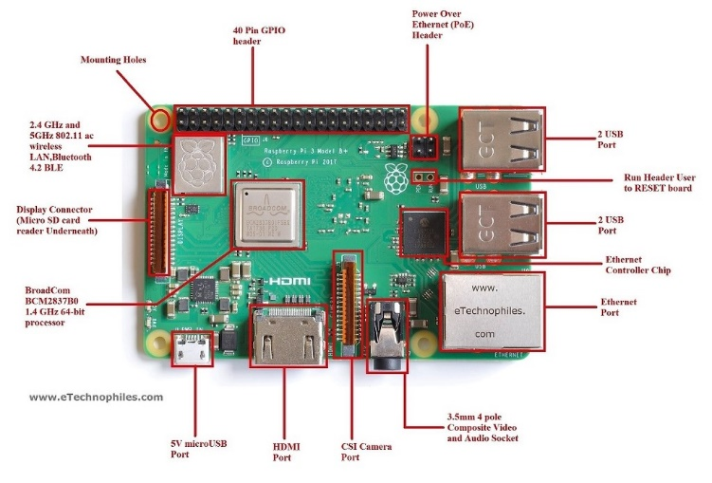
DESCRIPTION
Raspberry pi 3 model B :-

Slide 10
PROCESSOR : BOARD COM BCM 283 7B0, CORTEX –A53 64 BIT SOC @1.4 GHZ
MEMORY : 1GB LPDDR2 SDRAM
CONNECTIVITY :
1. 2.4GHZ, 5GHZ, WIRELESS LAN, BLUETTOH 4.2,BLE
2. GB ETHERNET OVER USB 2.0 (MAX THROUGH PUT 300MBPS)
3. 4*USB 2.0 PORTS
4. MICRO CRAD SUPPORT
INPUT POWER:
1. 5V/2.5A DC VIA MICRO USB CONNECTOR
2. 5V DC VIA GPIO HEADER
3.POWER OVER ETHERNET (PoE)- ENABLED
ENVIRONMENT :- OPERTAING TEMP. 0-50℃

Slide 11
APPLICATION
Major appliction for doctors to dignos depression
Early detection of dipression

Slide 12
CONCLUSION
We will get 93 % accuracy from left hemisphere signals and 95% accuracy from right hemisphere of brain at output of our diagnosis
This observation will get us level of depression
Depression is classified based on a severity index into mild, moderate and major classes

Slide 13
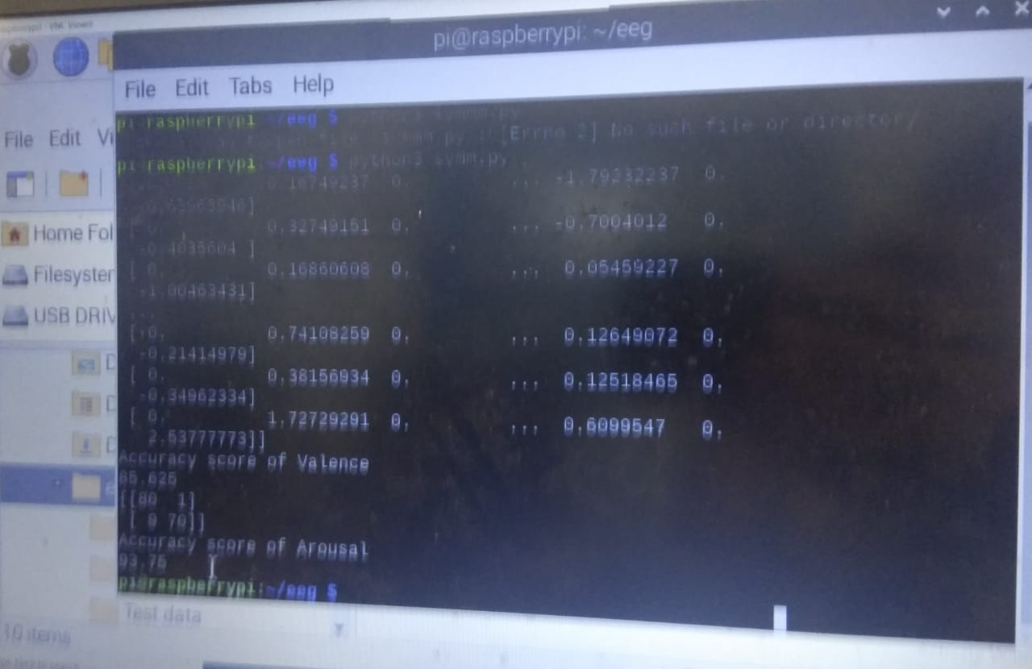
OUTPUT

Slide 14
References
World Federation for Mental Health, “Depression: a global crisis,” Occoquan, VA, USA, (2012).
National Institute of Mental Health Brain basics, “https://www.nimh.nih.gov/health/index.shtml#GrowingBrain,” last accessed 2019/01/20.
M. Ahmadlou, H. Adeli, A. Adeli, “Fractality analysis of frontal brain in major depressive disorder,” International Journal of Psychophysiology 85 (2012) 206-211.
V. K. Sudarshan, U. R. Acharya, H. Adeli, J. Santhosh, J. E. W. Koh, S. D. Puthankattil, and A. Adeli, “A novel depression diagnosis index using nonlinear features in EEG signals,” European Neurology 74 (2015) 79-83 .
M. Hussain, W. Mumtaz, L. Xia, S. S. A. Ali, M. A. M. Yasin, A. S. Malik, “Electroencephalogram (EEG)-based computer-aided technique to diagnose major depressive disorder (MDD),” Biomedical Signal Processing and Control 31 (2017) 108-115.

Slide 15
THANK YOU

